Slide 1
Basic Details of the Team and Problem Statement
Ministry/Organization Name/Student Innovation:
PS Code: 1369
Problem Statement Title: Online integrated platform for projects taken up by the students of various universities/colleges
Team Name: Script Slingers
Team Leader Name: Pranav Kishor Patel
Institute Name: Vishwakarma Institute of Technology

Slide 2
Idea/Approach
PROBLEM STATEMENT : Online integrated platform for projects taken up by the students of various universities/colleges.
Creating a comprehensive platform for student project sharing in Indian universities and colleges is a complex endeavor. Here are some ideas and an approach to consider when implementing such a platform:
1. Streamlined Project Registration:
2. Plagiarism Checking:
3. Encourages Collaboration:

Slide 3
Idea/Approach
Approach of going through the project:
1.Research Phase: Conducting a survey to now what are basic requirements and expectations from a website .
2.Platform Development :Developing the UI/UX, finalizing technologies for the frontend and identifying the database system to be used.
3.Project Submission: To make a user friendly and easy platform for the submission of the project.
4.Administration Model :To make an proper system where the colleges can register themselves before uploading any project from their college.
5.Feedback/Discussion Forum: Feedback on the projects will be given along with suggestions.

Slide 4








Technology stack
HTML
CSS
JavaScript
MongoDB
ReactJS
NodeJS
AWS/Azure​

Slide 5
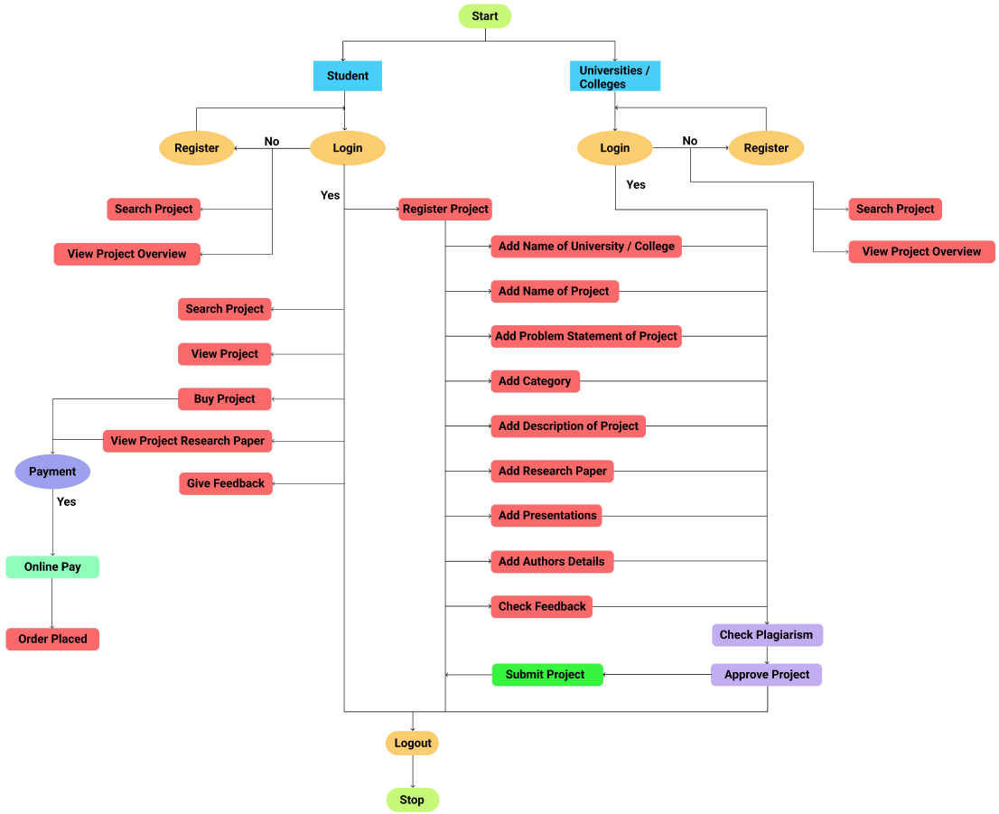
Flow chart

Slide 6
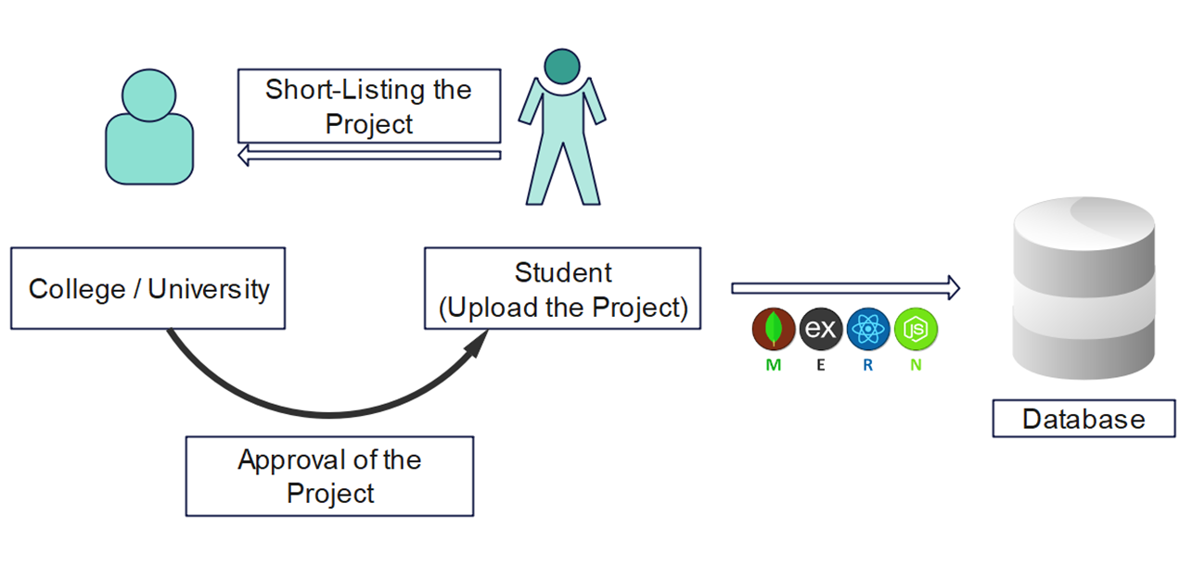
System Architecture

Slide 7
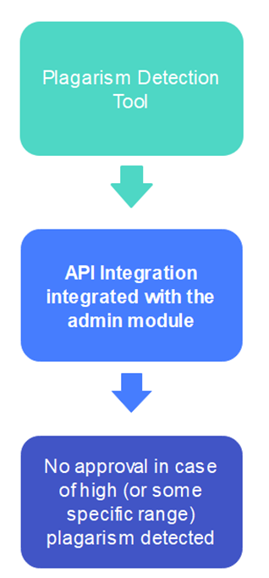
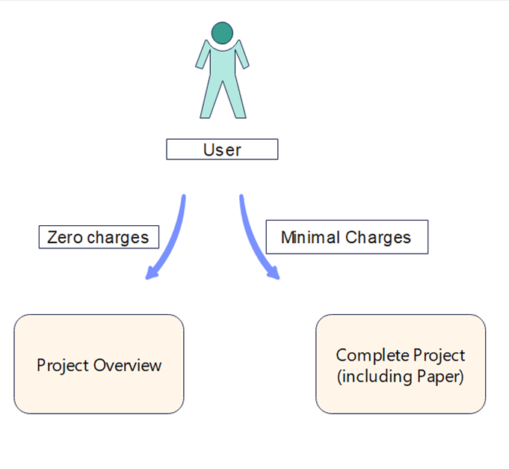
System Architecture

Slide 8
Business Model
Subscription model based on monthly basis
Life time access to a project through project subscription.
Providing the sponsorships for ongoing projects

Slide 9
Describe your Use Cases here
Showcase of Projects
Peer-to-peer learning is possible
Cross-functional platform
plagiarism checker
Student feedback

Slide 10
Dependencies
Data protection
Collaboration with educational institutions
Server infrastructure and hosting services
Plagiarism detection tools
Feedback system
Fundings, Marketing and Training.

Slide 11
Features
Cross-functional Research between the Colleges/Universities
Plagiarism Detector
QR/Project Export
Sandbox environment
Project Rating
Chatbot Assistance
Appreciation Model
Discussion Forums

Slide 12
Team Member Details
Team Leader Name: Pranav Patel
Branch (Btech): Stream (IT): Year (II):
Team Member 1 Name: Rishi Jain
Branch (Btech): Stream (IT): Year (II):
Team Member 2 Name: Harshwardhan Ajay Patil
Branch (Btech): Stream (IT): Year (II):
Team Member 3 Name: Tanishka Chandrasen Jagtap
Branch (Btech): Stream (IT): Year (II):
Team Member 4 Name: Rukmoddin Nabab Patel
Branch (Btech): Stream (CSE): Year (II):
Team Member 5 Name: Kriya Jain
Branch (Btech): Stream (AIDS): Year (II):

Slide 13
Thank You !!!..

